Slide 1
2021 NC CCIM Market Forecast
RSE predicts 2021 will be the Year of Yogi?
The year when Berra-isms make economic sense!
KC Conway, CCIM, CRE, MAI
CCIM Institute Chief Economist
Principal & Co-Founder of
Red Shoe Economics
KC@RedShoeEconomics.com
www.RedShoeEconomics.com
Celebrating 40 years of providing relevant high quality education, designation promotion, useful resources, and networking opportunities creating value for our members, and partners.
Chapter President, Patrick Murray, CCIM, CLS

Slide 2
Disclaimer: Not in the fine print…
NC CCIM 2021 Statewide Markets Economic Forecast
K.C. Conway, CCIM, CRE, MAI and CCIM Institute Chief Economist
This presentation reflects the analysis and opinions of the author, K. C. Conway,
but not necessarily those of NC-CCIM, CCIM Institute, or Red Shoe Economics.
Neither NC-CCIM, Event Sponsors, CCIM Institute, Monmouth MREIC, nor Red Shoe Economics make any representations or warranties about the accuracy or suitability of any information in this presentation. The aforementioned do NOT guarantee, warrant, or endorse the advice or services of K.C. Conway, CCIM, CRE, MAI.
Association for Corporate Growth
This presentation consists of materials prepared exclusively by K.C. Conway, CCIM, CRE, MAI and is provided during this event solely for informational purposes of attendees. This presentation is not intended to constitute legal, investment or financial advice or the rendering of legal, consulting, or other professional services of any kind.
You can follow Red-Shoe Economics on LinkedIn or obtain more information at our website: http://www.redshoeeconomics.com/
KC@RedShoeEconomics.com
2

Slide 3
2021 Outlook: The Year of Yogi
NC CCIM – What to Expect for 2021
“The future ain't what it used to be.”
“It ain’t over till it’s over.”
“You’ve got to be very careful if you don’t know where you are going, because you might not get there.”
“You better cut the pizza in four pieces because I’m not hungry enough to eat six.”
3

Slide 4
Test Your Knowledge: What Red-Shoe Economist will Answer?
Sponsored by:
Visual Capitalist is a MVP resource to use. It is great at visualizing data. At Yr-End 2020, Charlotte was among the top 25 cities in aggregate Real Estate value. This ranking will change over the next 5 years with more migration South.
A record 52% of 18-29 year-olds live at home with mom & dad. That exceeds the record 48% set in WW II and the 1940s. What does that foretell for delayed household formation and retail activity in the economy?
Where did NC & SC rank in the 2020 U-Haul migration report for net in-bound moves? #9 & #15. TN, TX, FL ranked #1, #2, #3 and NC surpassed GA as #10
What property types are likely to experience the most credit distress in 2021? Hotel and retail. But don’t take Office off your radar or MF. Why? We don’t know what we don’t know about return to work in the city or how MF rent forbearance plays out. Could MF rent forbearance morph into rent forgiveness under a Biden Admin?
What one metric will dictate Covid recovery in 2021? Vaccination success! What is the go-to resource to track vaccinations by state? Becker’s Hospital Review.
Life expectancy dropped a full year in 2020 to 77.8 years, but women shouldn’t worry. Women still outlive men by 5.4 years.
In 2020, CRE transactions fell below that of 2019 (<$500b), but all the Stock Market indices were at all-time record levels on Dec 30, 2020.
Track Challenger Job Cuts for a Forward-View on Jobs. In 2020, a record 2.2 million were cut. Jan 2021 job cuts were not led by “Covid19” cuts, but more structural “Downturn” type.
Logistics has been the big winner in 2020 and Covid19. It’s a good thing Logistics was ready for Covid19 so it could handle the record 3 billion packages shipped between Thanksgiving & Christmas. NC & SC are well positioned to benefit with CSX & NFS rail, South Carolina State Ports Authority (SCSPA) & Charlotte-Douglas airport.
The real housing story is the “other Quartile” not mentioned by the media or NAR in which 1 in 4 Am. Households are in rent or mortgage forbearance programs and 5.2% of all mortgages are delinquent. If not for the record $2.0 trillion in MBS purchases by the FED, maybe we would be having a 2009-type housing crisis.
4

Slide 5
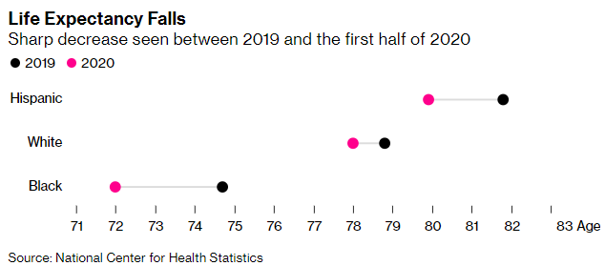
Test Your Knowledge: Life Expectancy – Women outlive Men 5.4 years
Life expectancy at birth dropped to 77.8 years from 78.8 in 2019, according to provisional data from the National Center for Health Statistics. The report also showed widening disparities along racial and gender lines. Black men saw a three-year decline in life expectancy, while the gap between the sexes rose to 5.4 years, the most in more than two decades.
https://www.bloomberg.com/news/articles/2021-02-18/u-s-life-expectancy-plunged-in-2020-by-most-since-world-war-ii?cmpid=BBD021821_OUS&utm_medium=email&utm_source=newsletter&utm_term=210218&utm_campaign=openamericas
5

Slide 6
A Red Shoe Economics FOUNDING Sole Supporter
Spotlight on:
CompStak creates transparency in commercial real estate markets by gathering information that is hard to find, difficult to compile, or otherwise unavailable.
Sourced from a nationwide network of 30,000+ CRE professionals, CompStak is the only provider of a lease and sales comp dataset built directly from real-time, signed transactions.
For information about CompStak, please email Brian Caldwell at brian.caldwell@compstak.com or call 734-276-1268."
For information about becoming a Red-Shoe Sole Supporter, email info@RedShoeEconomics.com
6

Slide 7
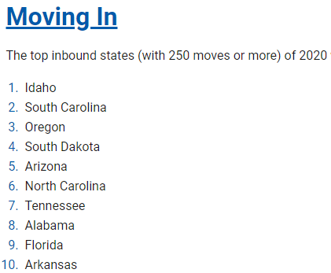
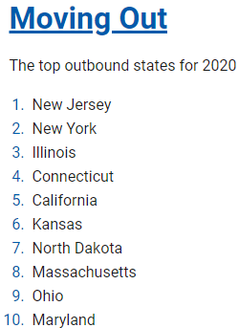
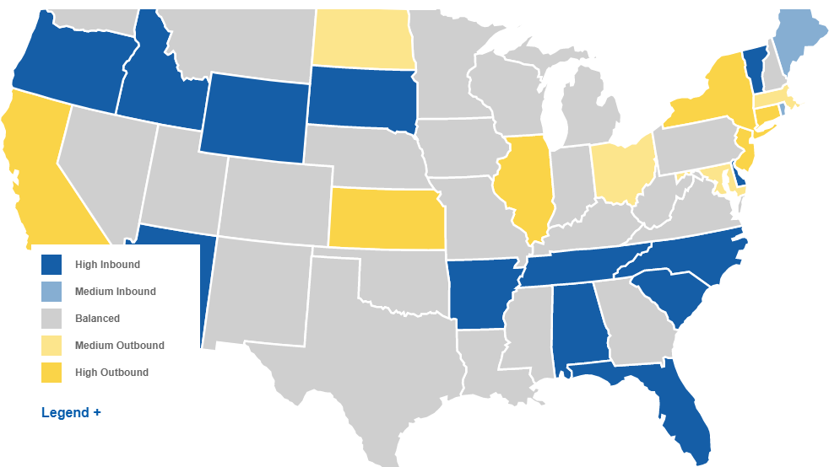
Opening Perspective: Where did Americans move in 2020?
United Van Lines’ National Migration Study
Note the in-migration to states around GA.
More 2021
in-migration to SE,
Idaho was the state with the highest percentage of inbound migration (70%) among states experiencing more than 250 moves*
Topping the list of outbound locations was New Jersey (70% outbound), which has held the spot for the past three years.
Among the top inbound states were South Carolina (64%), Oregon (63%), South Dakota (62%) and Arizona (62%), while
New York (67%), Illinois (67%), Connecticut (63%) and California (59%) were among the states experiencing the largest exoduses.
United Van Lines also conducts a survey examining the reasons behind Americans’ migration patterns. 2020 results indicate
40% of Americans who moved did so for a new job or job transfer, and more than one in four (27%) moved to be closer to family
https://www.unitedvanlines.com/newsroom/movers-study-2020?utm_campaign=National-Movers-Study&utm_source=twitter.com&utm_medium=social&utm_content=press-release
7

Slide 8
The U-Haul Report: Where did Americans move in 2020?
2020 Migration Trends: U-Haul Ranks 50 States by Migration Growth
Tennessee claims No. 1 spot for first time; Texas in top 2 for fifth straight year
U-Haul customers made Texas and Florida their top two destinations from 2016-19. Texas had the largest net gain of one-way U-Haul trucks for three consecutive years before Florida flipped the order and became No. 1 last year. Texas is second for growth, and Florida third, for 2020.
Ohio, Arizona, Colorado, Missouri, Nevada, North Carolina and Georgia round out the top 10 states for 2020 growth as self-movers continue to migrate to the Southeast, as well as markets in the Southwest, Midwest and Rocky Mountain regions.
California ranks last by a wide margin, supplanting Illinois as the state with the greatest net loss of U-Haul trucks. California has ranked 48th or lower since 2016. Illinois has been 49th or 50th since 2015, when U-Haul began ranking states based on annual net gain.
1. | Tennessee (#12 2019) Amazon HQ2 kicking in
2. | Texas (#2 - Steady)
3. | Florida (1)
4. | Ohio (7)
5. | Arizona (20)
6. | Colorado (42)
7. | Missouri (13)
8. | Nevada (24)
9. | North Carolina (3)
10. | Georgia (16)
11. | Arkansas (#23 2019)
12. | Indiana (9)
13. | Wisconsin (41)
14. | Oklahoma (14)
15. | South Carolina (4) (#2 by United Van Lines)
16. | West Virginia (22)
17. | Utah (8) Understated!
18. | Kentucky (37)
19. | Montana (26)
20. | Minnesota (15)
40. | Michigan (48) Moving Up
41. | Pennsylvania (46)
42. | New York (43)
43. | Connecticut (34)
44. | Louisiana (40) Hurricanes?
45. | Oregon (29)
46. | Maryland (45) The EXIT
47. | Massachusetts (47)
48. | New Jersey (44)
49. | Illinois (50)
50. | California (49)
Methodology: Growth states are calculated by the net gain of one-way U-Haul trucks entering a state versus leaving that state in a calendar year. Migration trends data is compiled from more than 2 million one-way U-Haul truck customer transactions that occur annually.
https://www.uhaul.com/Articles/About/22746/2020-Migration-Trends-U-Haul-Ranks-50-States-By-Migration-Growth/
8

Slide 9
Speaking of Moving: 18-29 YO’s have moved Home – Highest Percentage in History
Question:
Where will 18-29 year old’s be living if Mom & Dad can do remote work from a farm lake, beach, mountains - and this demographic can also do remote work?
Not in NY, NJ, DC, SF, LA, CHI or even Atlanta.
Try NC, SC, TN, TX, AZ, FL.
WW II
Covid19
https://www.visualcapitalist.com/us-young-adults-living-with-their-parents/
9

Slide 10
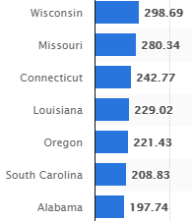
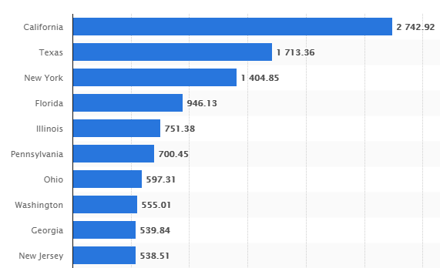
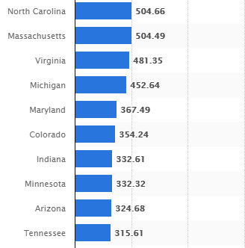
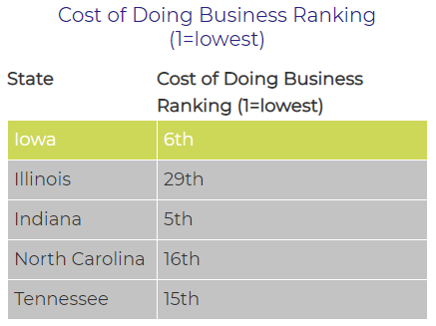
GDP by State (Q3 2020 YOY): What’s driving your State’s Economy? NC #11 & SC #26
Most GDP Decline in 2020 was
NV, TN & HI at >40%)
#21 to #27:
SC #26
Least GDP Decline in 2020 was
UT & AZ <25%)
Top 10 States with most $ GDP
TX > NY, FL > IL, GA > NJ, NC > MA & VA
#11 to #20 States NC >$500b and MA, VA
CO, AZ & TN are in a horse race to surpass $400b
What-If AL Unionizes Amazon?
https://www.statista.com/statistics/248053/us-real-gross-domestic-product-gdp-by-state/
10

Slide 11
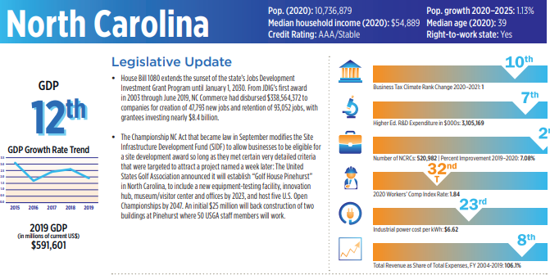
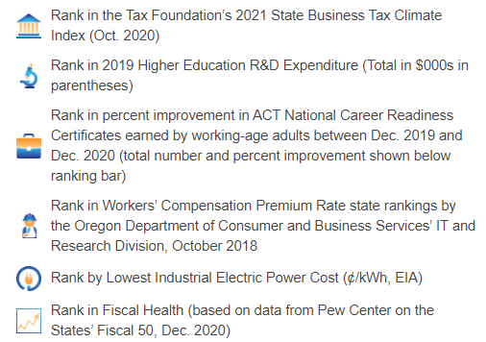
San Antonio – Navistar
Springhill TN – Cadillac EV
Huntsville – Space Command HQ
MD – New Cash Printing Plant
NC – Gilead (Wake Co) & Epic Games
https://siteselection.com/issues/2021/jan/state-of-the-states-2021-cover.cfm
11

Slide 12
Fortnite’s parent company
is turning a North Carolina mall
into its headquarters
Gilead to bring
275 high-paying jobs to
Wake County
https://qz.com/1953205/fortnites-parent-company-is-buying-a-mall-for-its-headquarters/
https://www.bizjournals.com/triangle/news/2021/02/09/gilead-to-bring-high-paying-jobs-to-wake-county.html?b=1612888274%5E21857302
Epic Games, the American video game and software development company behind the popular video game Fortnite, announced this week it was buying a mall in North Carolina, for its new headquarters.
Epic is purchasing the 980,000-square-foot Cary Towne Center, which sits on 87 acres, from developers who had previously announced plans to demolish the mall and build a new, mixed-use development. Epic’s plans for the mall are still shaping up, but it plans on moving from its current Cary location in 2024.
Pharma giant Gilead Sciences is bringing a business service operation to Wake County, a move that means 275 new jobs – positions that pay more than double the area’s average wage.
The jobs, according to the North Carolina Department of Commerce, will pay average wages of more than $142,000. The county average is above $63,000.
Gilead (Nasdaq: GILD) is headquartered in California and picked the Triangle over a competing offer in Atlanta, one that came with the a $10 million incentives offer.
12

Slide 13
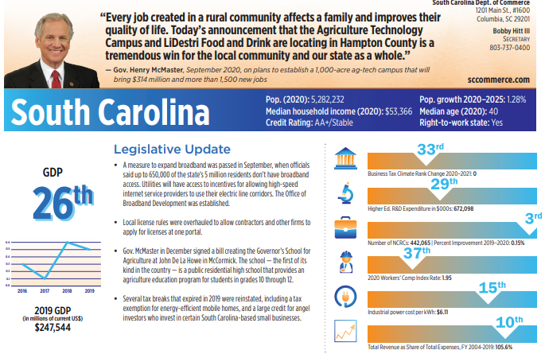
San Antonio – Navistar
Springhill TN – Cadillac EV
Huntsville – Space Command HQ
MD – New Cash Printing Plant
Boeing – WA to SC consolidation
https://siteselection.com/issues/2021/jan/state-of-the-states-2021-cover.cfm
13

Slide 14
Cassie Franklin, mayor of Everett, Washington, and Snohomish County Executive Dave Somers pulled into the vast parking lot at Boeing Commercial Airplanes headquarters in Renton, Washington, one day in early October for a private meeting with Stan Deal, the CEO of the company’s most important business. “There were about six cars in the parking lot,” Somers recalled to the Puget Sound Business Journal. The civic leaders stared at each other in amazement. In normal times, hundreds of cars dot Boeing Co.’s parking lots outside the sprawling 855,000-square-foot office complex. Inside, minutes later, the pair learned the business landscape was about to start changing, too.
Deal announced that the $100 million complex would be put up for sale. He told Somers and Franklin that Boeing didn’t need that much space anymore. Boeing Chief Financial Officer Greg Smith revealed a few days later that all the jet maker’s properties were being examined. “We’re reviewing every piece of real estate. Every building, every lease, every warehouse, every site, to see how we can be more efficient,” Smith said during a call with investment analysts, revealing that the Chicago-based jet maker aims to slash its global real estate footprint by 30%. As those moves play out, they’re expected to send ripple effects throughout the Seattle region as well as the overall aerospace industry.
The assessment is happening as Boeing prepares to move all production of its 787 widebody jets from Everett, Washington, to its facility in North Charleston, South Carolina, this spring, months sooner than had been anticipated.
https://www.bizjournals.com/seattle/news/2020/12/30/boeing-cre-strategic-review-cut-cre-expenses.html?b=1609366538%5E21816483&utm_source=st&utm_medium=en&utm_campaign=tko&ana=e_tno
14

Slide 15
5 Ways COVID-19 Changed Site Selection
“The suburbs are making a strong comeback,” especially in those states having their fiscal houses in order.”
“Clients will also be redeploying to Tier 2 and Tier 3 metros.” There will be a “consolidated office strategy because of satellite offices being used instead of large corporate locations.”
Texas claimed the top spot once again, followed by North Carolina, Florida, and Virginia followed by a four-way tie for fifth among Missouri, Ohio, South Carolina and Tennessee. Rounding out the top 10 states were Georgia, Indiana, Michigan and Utah,
NC #2 and SC tie for #5
https://siteselection.com/issues/2021/jan/site-selectors-survey-five-ways-covid-19-changed-site-selection.cfm?utm_source=Sidebar&utm_medium=Web&utm_campaign=Optimize&utm_content=MP
High taxes and lack of qualified workers were once again cited as the most common location deal-killers. abrasive local politics was cited frequently as a project deal-killer, and “communities over-promising and under-delivering.”
15

Slide 16
2021 Outlook: 10 Items to Monitor for CRE Impact
Vaccination Success – Becker’s
Bank Failures & TX Ratio
Do you know your Bank’s TX Ratio and how does that correlate to ALLL?
Transportation Metrics – TSA Passenger Count
Housing: Foreclosures & MF Evictions post Rent & Mortgage Forbearance Programs
State Fiscal Health – Chapter 9 BKs
Returning to the Office:
Kastle Key Card Systems Data and Office Sublet space.
Supplement with Challenger Job Cuts
Federal Reserve Balance Sheet
$2.0 Trillion in MBS is preventing a 2009 type Housing Crisis.
Earnings Watch & Bank ALLL
CRE Credit Metrics
TREPP LTSS and CMBS DQT Rates.
Logistics – eCommerce – Adaptive Reuse
And 1 more: ESG
KC@RedShoeEconomics.com
16

Slide 17
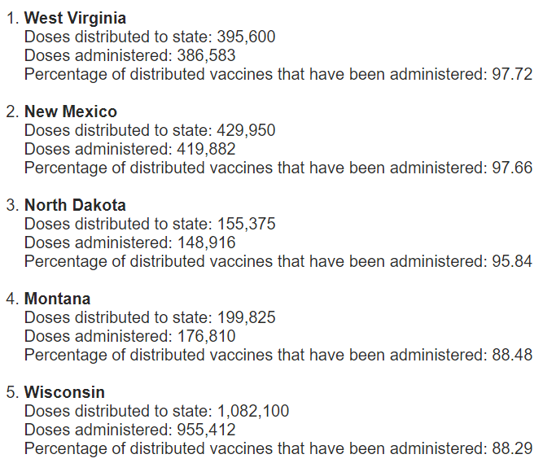
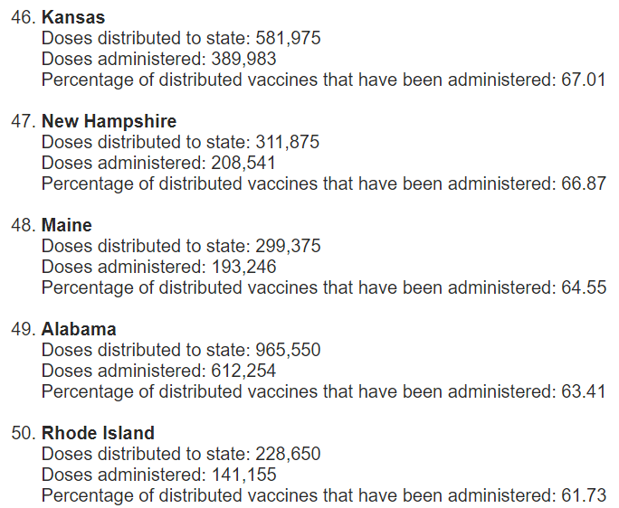
Covid19 Vaccinations in 2021
States ranked by percentage of COVID-19 vaccines administered: Feb. 11
State economies and CRE Values will be directly correlated to vaccination success.
Occupancy Restrictions and High CRE vacancy will persist where vaccination success is low.
https://www.beckershospitalreview.com/public-health/states-ranked-by-percentage-of-covid-19-vaccines-administered.html
17

Slide 18
Financially Strong Health Care Systems
NC ranks #2 among the Top 11 across the US
Winston-Salem, N.C.-based Novant Health has an "AA-" rating and stable outlook. The system has strong margins, and each of its markets has met or exceeded budgeted expectations over the past four years.
Charlotte, N.C.-based Atrium Health has an "Aa3" rating and stable outlook with Moody's and an "AA-" rating and stable outlook with S&P.
Atrium and Winston-Salem, N.C.-based Wake Forest Baptist Health merged in October. The addition of the Winston-Salem service area and Wake Forest Baptist's academic and research programs enhances Atrium's position within the highly competitive North Carolina healthcare market.
https://www.beckershospitalreview.com/finance/11-health-systems-with-strong-finances-020821.html
18

Slide 19
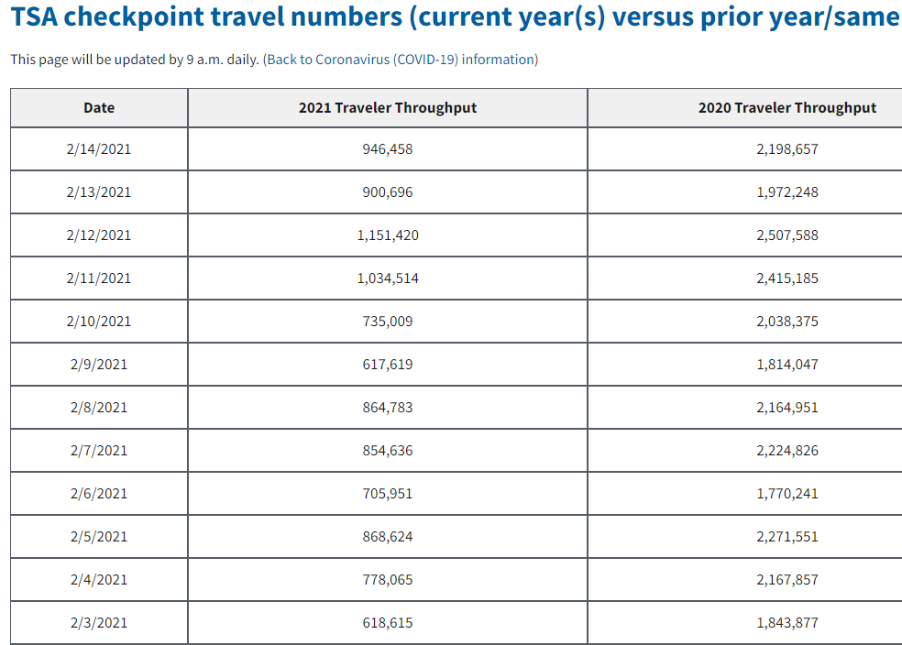
Transportation Metrics: TSA Passenger Count, Rail Traffic & Ports
North American Freight Rail Traffic Full-Year 2020
In December 2020, U.S. rail intermodal volume was up 12.2% over December 2019, its biggest monthly gain since February 2016. In Q4 2020, intermodal was up 11.2% over Q4 2019, its biggest quarterly gain since Q4 2010. For all of 2020, U.S. intermodal originations were 13.46 million containers and trailers — the fourth highest annual total in history (behind 2017, 2018, and 2019) and down 2.0% (276,904 units) from 2019. Six of the top 10 intermodal weeks in history were in 2020, all since week 43.
Air traffic off by >50% from
Pre-Covid.
Airlines’ Outlook is just 40%-45% utilization for 2021.
Route Cuts are a concern SE MSAs.
North American Freight Rail Traffic in January 2021
Total carloads averaged 232,576 per week in January, the highest weekly average for any month in a year. In January 2021, U.S. intermodal volume and carloads of chemicals were both higher than ever before.
U.S. railroads originated 1.17 million intermodal containers and trailers in January 2021, a new all-time record and up 12.1% (126,548 units) over January 2020. Trade-related port activity continues to drive the surge in intermodal volumes. The four major U.S. West Coast ports (Long Beach, Los Angeles, Oakland, and Seattle/Tacoma) had combined total TEU volumes up 18.4% over the fourth quarter of 2019. But rapid recent growth is not just a West Coast phenomenon. At the Port of Savannah, for example, fourth quarter TEU volume was up 19.5% in 2020 over 2019; at the Port of Charleston, fourth quarter TEU volume was up 7.2% in 2020 over 2019.
As airline Route Cuts hit Secondary MSAs; does “Driveable” become the new travel destination? Impact on 2nd –ary MSAs around ATL (AL, TN, SC)?.
Airline bankruptcies still a concern even with Biden $1.9Tr Relief Bill?
https://www.tsa.gov/coronavirus/passenger-throughput
https://www.aar.org/news/rail-traffic-for-the-week-ending-february-6-2021/
19

Slide 20
Charlotte Douglas sees streak of record passenger traffic snapped in 2020
By Jenna Martin – Digital Editor, Charlotte Business Journal Feb 11, 2021
Passenger traffic at CLT took a tumble last year as the public health crisis decimated business and leisure travel, especially early on in the pandemic.
Traffic dropped 46% to reach 27.2 million travelers, according to figures released Thursday by airport officials. That's down from an all-time high of 50.2 million passengers in 2019.
The airport's lowest passenger volume, by far, came in April — the first full month of the pandemic — when just 340,265 people traveled through CLT. Traffic figures slowly rebounded from there to reach about 2.8 million in October. Passenger counts were slightly down in November, at 2.29 million, and December, at 2.34 million.
The last time passenger traffic at Charlotte Douglas came in near the 2020 level was 15 years ago. That was in 2005, when the airport served 28.2 million people.
Prior to 2020, CLT had only recorded three annual drops in passenger traffic over the past two decades — down 1% in both 2016 and 2009, and down 2% in 2003.
“Nearly 30 million passengers is still a big number,” said Haley Gentry, CLT's acting aviation director and CEO, in a news release. "By far, it’s definitely not where we want to be, but we are faring much better than many of our counterparts who have seen passenger reductions between 60 to 70 percent.”
In 2020, there were just shy of 398,000 aircraft departures and arrivals logged at CLT, down 31% from 579,263 in 2019.
Charlotte Douglas currently offers nonstop flights to 180 destinations, including 35 international locations and three U.S. territories. That includes numerous routes that American Airlines Group Inc. (NASDAQ: AAL) — which operates 90% of flights at the airport — added in the past year to places like Appleton, Wisconsin; Bozeman, Montana; Sioux Falls, South Dakota; and Puerto Vallarta, Mexico. Southwest Airlines also launched service last year at CLT to Denver, St. Louis and Phoenix.
Cargo was more stable at CLT in 2020, dropping 5% year over year. There were 174,913 tons of goods transported last year through CLT, which benefited from a rise in e-commerce.
Airport officials, in the report on 2020 activity, touted the progress of Destination CLT, a $2.5 billion to $3.1 billion capital improvement initiative. Charlotte Douglas finished renovations to concourses A and C last year and remains on track to complete the terminal lobby expansion in 2025, the report stated.
20

Slide 21
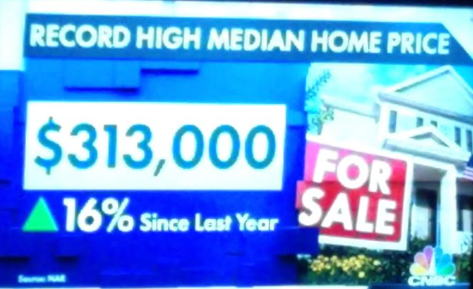
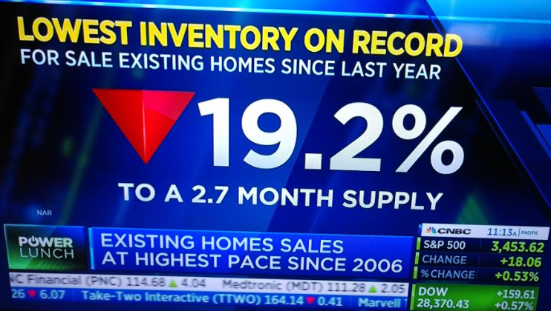
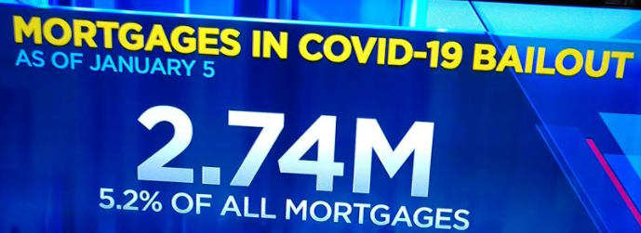
Housing: Which 2 Pictures tell the real Housing Story!
The Other Quartile in Housing: The one with 1:4 Am Households in Rent or Mtg Forbearance, or Mtg DQT
21

Slide 22
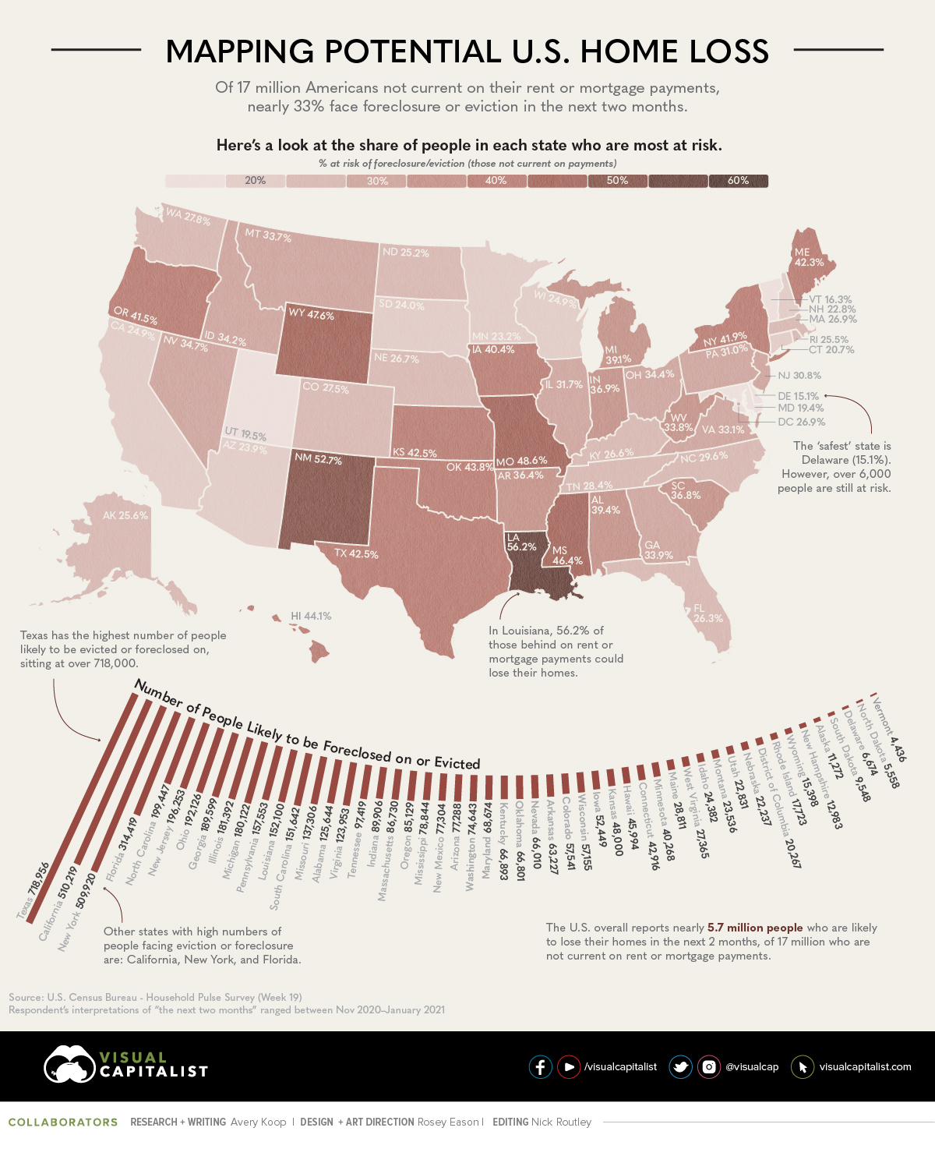
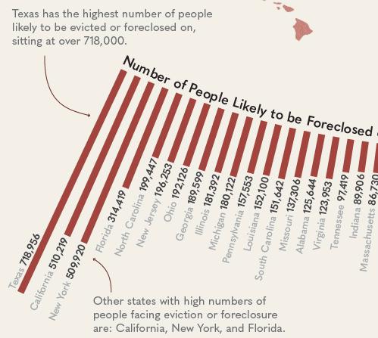
The risk is greatest for the following 10 states:
TX, CA, NY, FL NC, NJ, OH, GA, IL and MI.
https://www.visualcapitalist.com/mapped-the-risk-of-eviction-and-foreclosure-in-u-s-states/
22

Slide 23
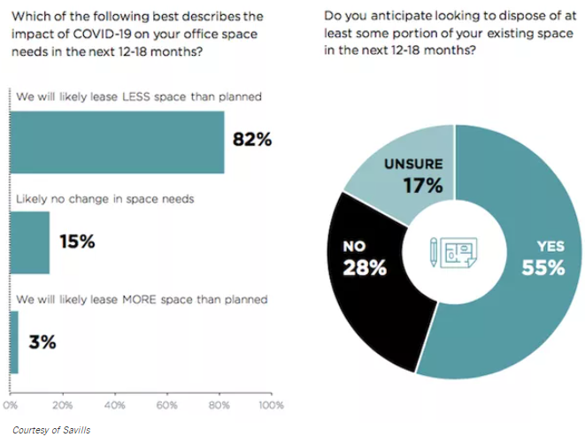
Office CRE: What is the Outlook with Remote Work?
Technology companies across the country expect to need less office space in the coming years, a sign of falling demand in the commercial real estate market.
Tenant representation firm Savills released a survey Thursday of 250 technology companies that found 82% anticipate needing less office space over the next 12 to 18 months, and 55% plan to dispose of existing space over that time period.
This disposal of space is already happening in a big way, with a wave of sublease listings hitting the market, Savills Executive Managing Director Zev Holzman said.
"Every day there is new sublease space hitting the market from tech companies of all sizes," Holzman said. "We're seeing a very steady flow of new subleases hitting the market."
Association for Corporate Growth
https://www.bisnow.com/national/news/office/more-than-half-of-tech-companies-plan-to-dispose-of-real-estate-in-coming-months-106271
23

Slide 24
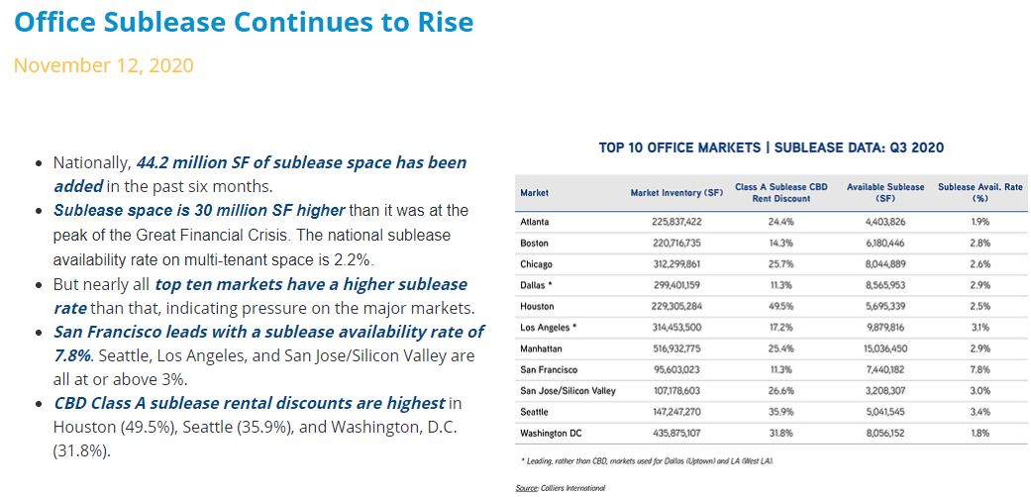
Office – Are we Returning to Work? Sublet is 1 of 2 key metrics to monitor
https://view.usa.colliers.com/?qs=966a632e96b0d0f8e9800a1f1b4feeeea7fc525b662d562df57b43a3a555e2601b69ae7507c3043bba773f2dab5bb0bfd9784719fab04f926293d4db6a54290bddd16ae8858651d2
Association for Corporate Growth
Office fundamentals have softened rapidly in this cycle. Vacancies have moved quickly as sublease space has hit the market fast and furiously. Already 44.2 million SF of sublease space has appeared in the past six months, with a national average of 2.2% availability for multitenant office, per CoStar. Major markets are facing a disproportionate share of this space
Class A CBD sublease discounts vary from 10%-15% in Dallas (11.3%) and Boston (14.3%), to 32% in Washington, D.C., to 50% in Houston. Manhattan sublease space is 25.4% below direct rents. With limited deal activity and still-high rates of remote work in many markets across the country, sublease space is expected to continue to increase in the quarters ahead.
24

Slide 25
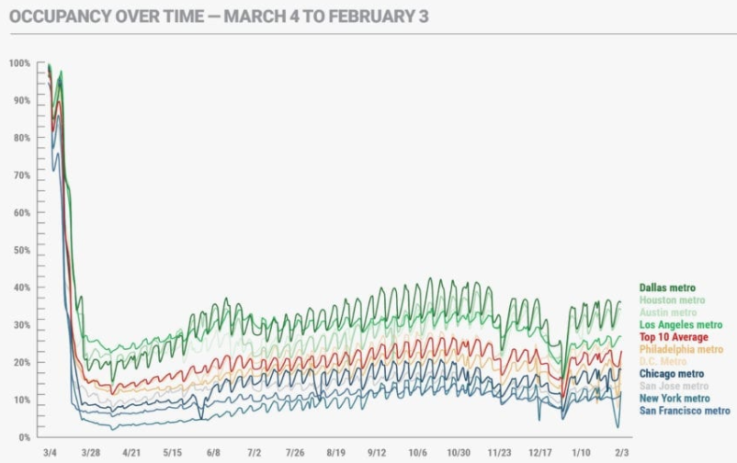
Office CRE:
The Other Metric
https://www.kastle.com/city-by-city-views-of-americas-office-use/
25

Slide 26
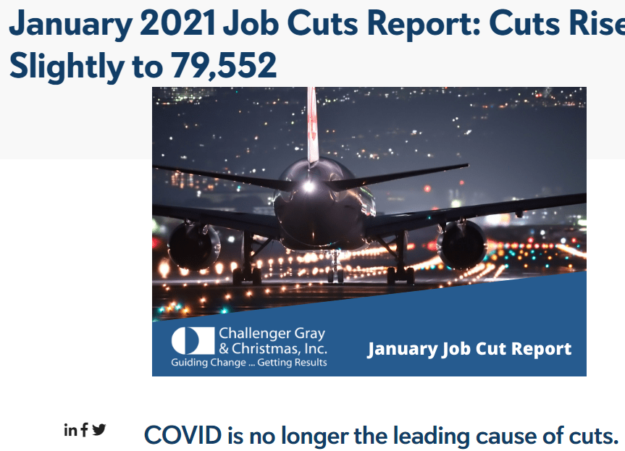
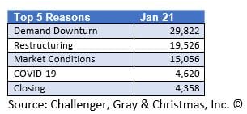
Final thought on “Returning to Work:” Who is cutting Jobs?
WHY ARE COMPANIES CUTTING?
The leading reason for job cut announcements in January was demand downturn, followed by restructuring. Market conditions accounted for 15,056 cuts in January. COVID-19 was cited for 4,620 job cuts in January.
https://www.challengergray.com/blog/january-2021-job-cuts-report-cuts-rise-slightly-to-79552/
26

Slide 27
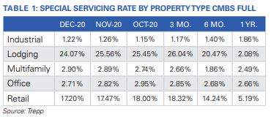
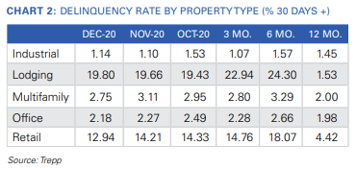
CRE Credit Metrics – LTSS, CMBS DQT, Bank Failures/TX Ratio
LTSS
The number of loans newly transferred to special servicing was about the same as November. A total of 60 loans were sent to special servicers in December in comparison to 61 the month before. Together, these loans hold an outstanding balance of $1.26 billion. About 42% of the new specially serviced loan balance was attributed to retail CMBS loans followed by lodging CMBS loans which accounted for about 28%.
The Trepp CMBS Delinquency Rate in December was 7.81%, a decline of 36 basis points from the November number.
Hotel loans continued to be the worst-performing segment, with the overall delinquency rate for that property sector climbing for the second straight month.
In terms of loans in grace period, 2.77% of loans by balance missed the December payment
27

Slide 28
How will this change post-Covid?
#7
What are the 30 Most Valuable U.S. Cities in terms of Total R.E. Value?
#1 NY - $2.8Tr # 2 LA - $2.3Tr
#3 San Fran - $1.3Tr # 4 CHI - $906b
#5 DC - $862b # 6 Miami - $774b
#7 Seattle - $700b # 8 Dallas $628b
#9 Houston - $535b #10 Atlanta - $531b
CHI #4
NY#1
#3
Covid will disrupt this map. As remote work migrates to 2nd/Tertiary MSAs, demand for CRE will rise!
DC #5
CHR #25
#2
ATL #10
DAL #8
HOU #9
#6
https://www.visualcapitalist.com/most-valuable-real-estate-cities-us/
28

Slide 29
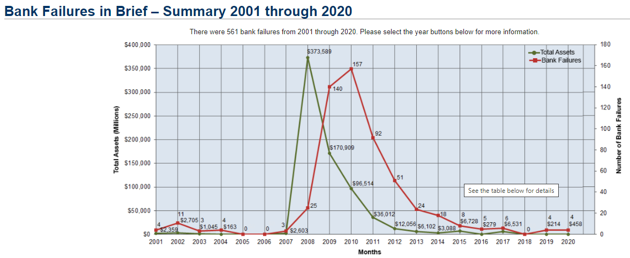
Bank Failures: They are back! Where is the Risk/Opportunity?
https://www.fdic.gov/bank/historical/bank/
29

Slide 30
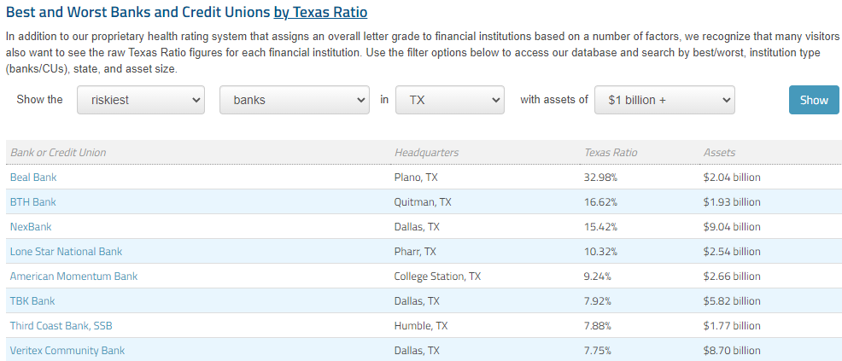
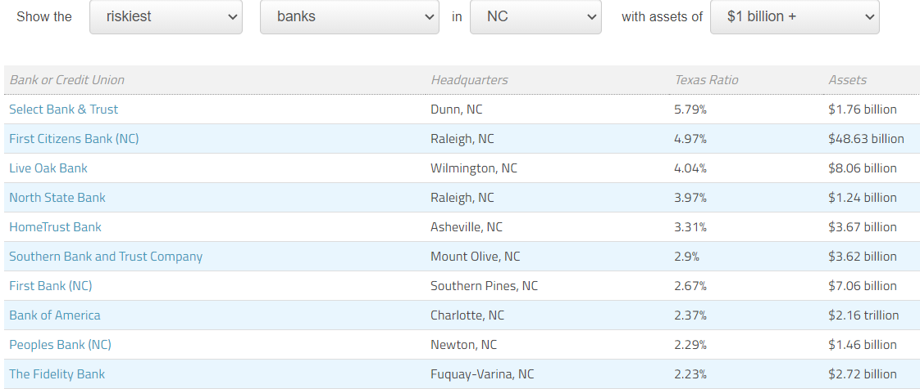
Where are the Healthiest Banks & CREDIT UNIONS?
A TX Ratio of 5% or below is considered healthy; above 10%-20% is concerning.
Texas Ratio
Developed at RBC Capital Markets, the Texas Ratio is a relatively straightforward and effective way to determine the overall credit troubles experienced by financial institutions. It is determined by comparing the total value of at risk loans to the total value of funds the bank has on hand to cover these loans. At risk loans are any loans that are more than 90 days past due and are not backed by the government. The amount of funds on hand consists of the loan loss allowance that the bank has set aside plus any equity capital.
For example, a bank with $65 million in at risk loans and $72 million in cash on hand to cover those loans would have a Texas Ratio of $65mm / $72mm, which is 90.3%. This figure is approaching the 100% threshold, which is considered very risky. You can also look at the trend in this Texas Ratio as an additional factor to tell if the bank's financial health is heading in the right direction.
What is the common denominator in the location of banks with high TX Ratios?
Leisure & Travel Dependence | Energy State | Hurricane Impacted
https://www.depositaccounts.com/banks/health.aspx
30

Slide 31
Banks – Join RSE for a unique Quarterly CRE & “Material Change” Series
Email RSE at: Info@RedShoeEconomics.com – Series starts in March and continues in June with Appraisal Impairment Reviews and Sept. with ALLL for CRE.
31

Slide 32
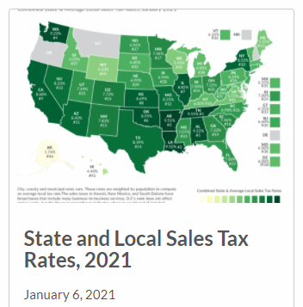
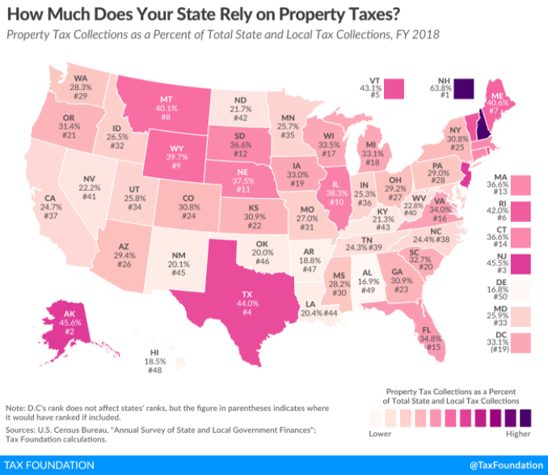
State & Local Gov. Fiscal Health – Composition of State Revenue
New Hampshire and Alaska relied most heavily on property taxes, which respectively accounted for 63.8 percent and 45.6 percent of their tax collections in FY 2018. Neither have individual income taxes.
Delaware and Alabama landed at the other end of the spectrum, raising the smallest portion of their state and local tax revenue through property taxes: 16.8 percent and 16.9 percent, respectively.
The five states with the highest average combined state and local sales tax rates are Tennessee (9.55 percent), Louisiana (9.52 percent), Arkansas (9.51 percent), Washington (9.23 percent), and Alabama (9.22 percent). T
The five states with the lowest average combined rates are Alaska (1.76 percent), Hawaii (4.44 percent), Wyoming (5.33 percent), Wisconsin (5.43 percent), and Maine (5.50 percent).
https://taxfoundation.org/state-property-taxes-reliance-2021/
32

Slide 33
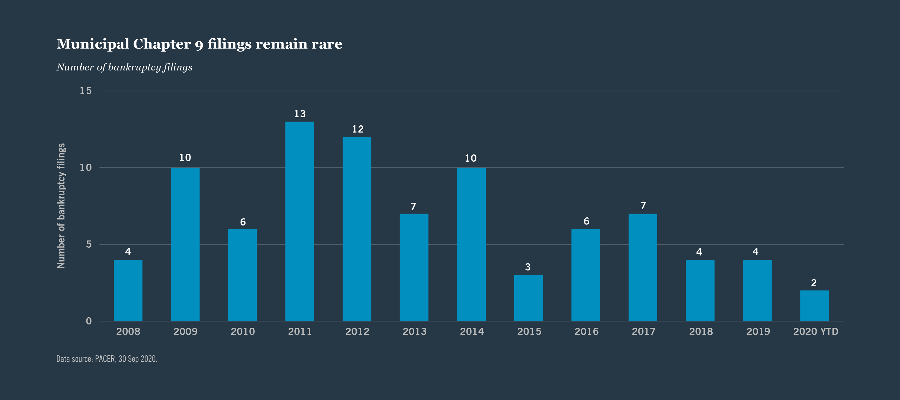
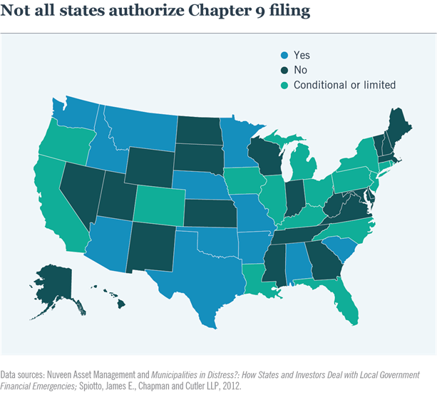
State & Local Gov. Fiscal Health – Chapter 9 Bankruptcies
Chapter 9 is Bankruptcy for counties and cities; expect 100-150 in the next 12-24 months.
Focus on “What If” thinking as to a city or county bankruptcy:
Can it be traded?
Can it be financed?
How to Value?
Go to NUVEEN.com for a historical perspective on Chapter 9 bankruptcies.
Not all states provide for Chapter 9 Bankruptcy. Nuveen has a good paper on this topic and which states don’t allow Chapter 9 BK. SC yes, NC is “Conditional”
https://www.nuveen.com/en-us/thinking/municipal-bond-investing/municipal-bankruptcy-a-primer-on-chapter-9
33

Slide 34
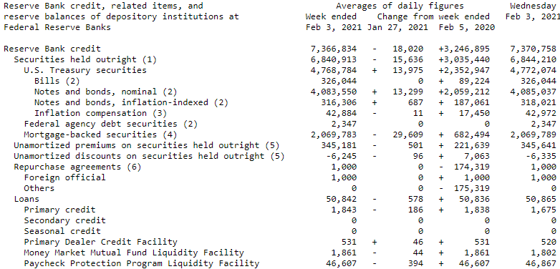
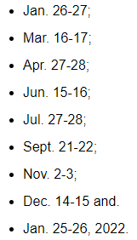
The Fed and
Its Balance Sheet:
Oh, It Matters!
2021
FOMC Meeting Dates
No coincidence 10-Yr hit 1.25% this week or Bitcoin $50k
10-Yr Tr spikes Nov 10 to 97bps from 51bps low Aug 4th. Jan 2021 >1.1% Why?
https://www.federalreserve.gov/releases/h41/current/default.htm
Why no recession, yet?
$5.0 Trillion Fiscal Stimulus by Congress with $2.0 Trillion more on the way
$3.2 Trillion Monetary Stimulus by the FED ($2.0 Tr in Housing/MBS)
KC@RedShoeEconomics.com
34

Slide 35
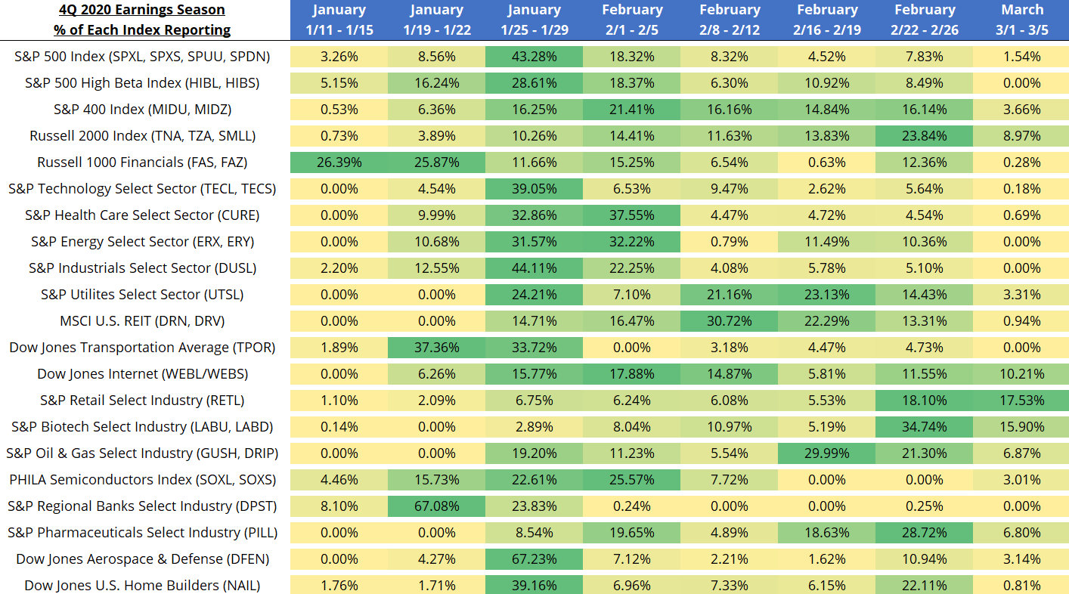
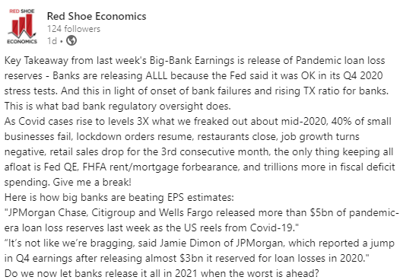
Earnings: Banks in Q4 skewed by Releasing ALLL built up in 2020
Track the companies impacting your local economy and the tenants in your CRE
https://markets.businessinsider.com/earnings-calendar#date=01/18/2021-01/24/2021&name=&countries=&eventtypes=103,99&tab=ALL
35

Slide 36
Last Mile Logistics: The Final and Most Expensive Link In the Supply Chain
Presented by
KC Conway, CCIM, CRE, MAI
CCIM Institute Chief Economist
KC@RedShoeEconomics.com
36

Slide 37
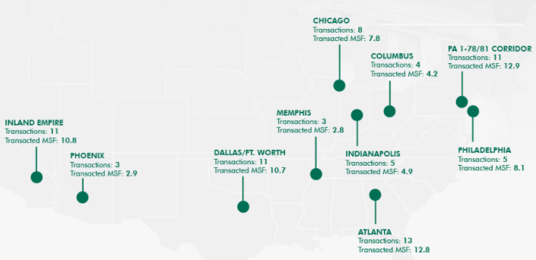
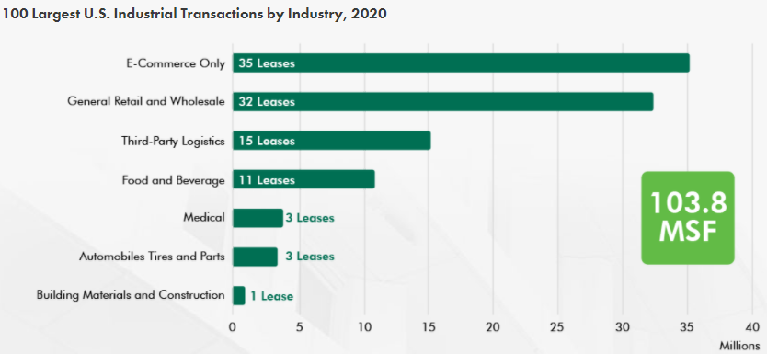
Industrial & Logistics CRE: Bifurcated between Large and RICs
The U.S. industrial market cemented itself as the most in-demand commercial property sector in 2020, fueled by a large increase in e-commerce sales due to COVID-19 restrictions. Demand for industrial buildings of all sizes surpassed 2019 totals but were strongest in mega-distribution facilities of 1 million sq. ft. or more. The top 100 transactions last year totaled 103.8 million sq. ft., 17% above 2019’s total.
#5
Top 10 MSAs for Large Warehouse Transactions
Tie#2
Tie#2
Tie#2
#1
https://www.cbre.com/research-and-reports/US-MarketFlash-Top-100-Industrial-Deals-of-2020
37

Slide 38
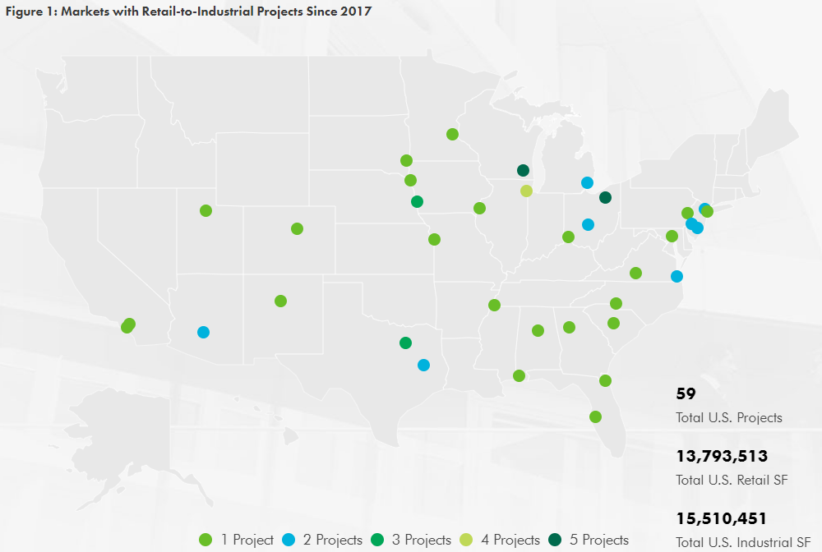
Retail-to-industrial property conversions are accelerating across the U.S., driven by the growth of e-commerce. There are now 59 such projects that have either been completed, proposed or are underway since 2017—up from 24 in January 2019, according to a CBRE Research survey. These projects total approximately 13.8 million sq. ft. of retail space converted to 15.5 million sq. ft. of industrial space.
Underperforming retail sites have become an ideal location for last-mile warehouse developers.
https://www.cbre.us/research-and-reports/US-MarketFlash-Retail-to-Industrial-Property-Conversions-Accelerate?utm_source=CampaignLogic&utm_medium=email&utm_campaign=Evolution+of+Online+Retail+Accelerates+Retail-to-Industrial+Conversion+Projects+Across+the+U.S._07/23/2020
38

Slide 39
(RICs) Retail-to-Industrial Conversion – December 2020
Amazon Buys Former Kmart in Hampton, Virginia, for Future Last-Mile Delivery Center
Site of 'Long-Vacant Eyesore' Rezoned for Industrial Use
A former Super Kmart described as a "long-vacant eyesore" by Hampton, Virginia, Mayor Donnie Tuck has been acquired by Amazon with plans to convert the property into a last-mile delivery center. The e-commerce giant closed on a deal to buy the 94,649-square-foot building at 210 W. Mercury Blvd. where it plans to construct a 100,000-square-foot facility it said will expedite delivery times to consumers in the region. The facility is expected to create 200 new jobs and is slated to open next year.
Amazon filed an application request to rezone the roughly 21.2-acre site for the construction and operation of a new warehouse and distribution center. The property had an asking price of $6.2 million. Additionally, Amazon said it plans to open a delivery station in Norfolk after subleasing the 165,000-square-foot property from longtime tenant, Schneider Logistics.
The expansion is the latest in the Hampton Roads area for Amazon. In March, the company disclosed plans to invest $250 million to build a pair of massive operations facilities that together are expected to bring 1,500 jobs to the Tidewater area. That includes a new robot-powered fulfillment center in Suffolk that, at 3.8 million square feet, would be the largest industrial building in the state.
https://product.costar.com/home/news/shared/518715667
39

Slide 40
Join Red-Shoe Economics for a Special Webinar
Analyzing the new ASCE Infrastructure Report Card March 4th.
What does it mean for NC, SC, etc.?
Email interest in registering for this special webinar to:
Info@RedShoeEconomics.com
40

Slide 41
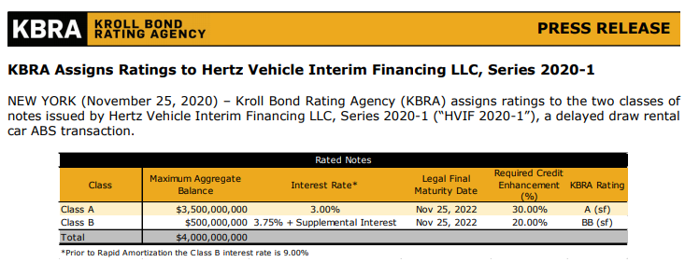
ESG & Top 5 Forward-Looking Metrics for 2021
#1 - Vaccination Success by State
#2 – TSA Passenger Count Transport Metrics (AAR.org)
#3 – Kastle Systems – Back to the Office
#4 – CRE Credit Metrics - Triangulate TREPP LTSS & CMBS DQT with FDIC Failed Banks and then TX Ratio.
Association for Corporate Growth
#5 – Fiscal Health of Companies & Municipalities
https://www.krollbondratings.com/documents/press-release/31362/kbra-assigns-ratings-to-hertz-vehicle-interim-financing-llc-series-2020-1
41

Slide 42
Thank You – Proudly Serving CCIMs “8 Days A Week.”
Red Shoe Economics is a research firm exclusively supporting today’s Commercial Real estate industry in the areas of economics, forecasting, and consulting. Our promise is to deliver unique views “eight days a week” that connect the dots from the deluge of daily market information to develop actionable insights for CRE stakeholders.
www.RedShoeEconomics.com
Economics
Forecasting
Consulting
Corporate Earnings Reports
Ports & Logistics Trends
Banking Regulations Updates
Housing Economics
Environmental Risk Management
Macro Economics
Key Note Presentations
Red Shoe Review (Newsletter)
Webinars (virtual )
Podcasts/Articles/
Interviews
Real Estate Finance
Special Projects
CRE Expert Witness
Tax Appeals
MSA Market Level Monitoring
Site Selection
Site Feasibility Studies
Valuation and Risk Analysis
Impaired Appraisals
RSE’s Founding Principals are
Beverly Keith, CCIM, CRX
Karen Mankowski, CCM, Leed AP
KC Conway, CCIM, CRE, MAI
Send your email address to info@redsoeeconomics.com to be added to the distribution list for KC’s Red Shoe Review newsletter
42

